Slide 1


Mount Litera Zee School, Ahmednagar
Welcome to Parents’ Induction
At Mount Litera Zee School, Ahmednagar
Greetings !!!!!!!!!
Lets see the plans we have made during COVID-19 for the Academic Session
2020-2021

Slide 2

Overview
Zee Learn is India’s leading company in education segment with the fastest growing chain of K-12 schools – Mount Litera Zee School and Asia’s No 1 chain of pre-school network – Kidzee in its portfolio.
With one most advanced teaching methodology – Litera Octave,
Zee Learn under its brand name Mount Litera Zee Schools provides promising education to the future generation enabling
them to explore their true unique potential.
Awarded as the ‘K-12 School Chain of the Year’
at Indian Educational Congress in 2015,
Mount Litera Zee school has over 90 schools
in 80+ cities nationwide.
Mount Litera Zee School, Ahmednagar
Mount litera zee school, Chandrapur

Slide 3
Mission Statement
“Our mission is to lead in generating practical and theoretical knowledge that enables students to better understand our world and improve conditions for local and global communities.
Mount Litera Zee School, Ahmednagar

Slide 4
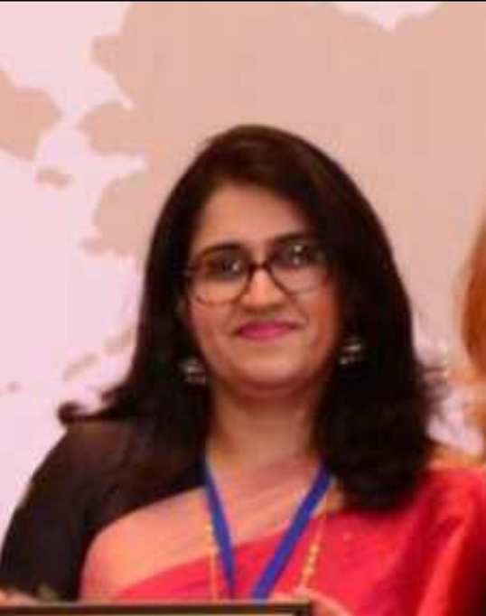
Our Mentor
Regional School Director West Zone Zee learn
Name :- Ms. Satwant Palekar
Ph. No. :- 9819987979
E-mail :- satwant.palekar@zeelearn.com
Mount litera zee school, Chandrapur

Slide 5
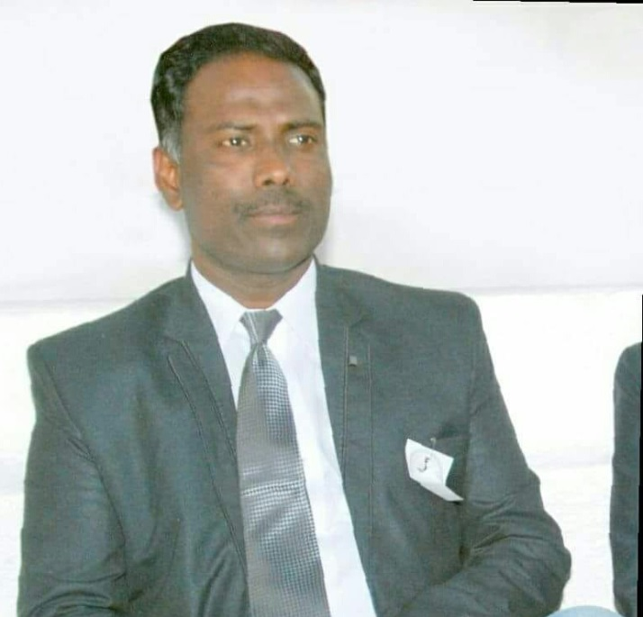
For Your Reference
Principal
Name :- Mr . Sachin Kanade
Ph. No. :- 9226799184
E-mail :-mlzsahmednagar@gmail.com
Mount Litera Zee School, Ahmednagar
Mount litera zee school, Chandrapur

Slide 6
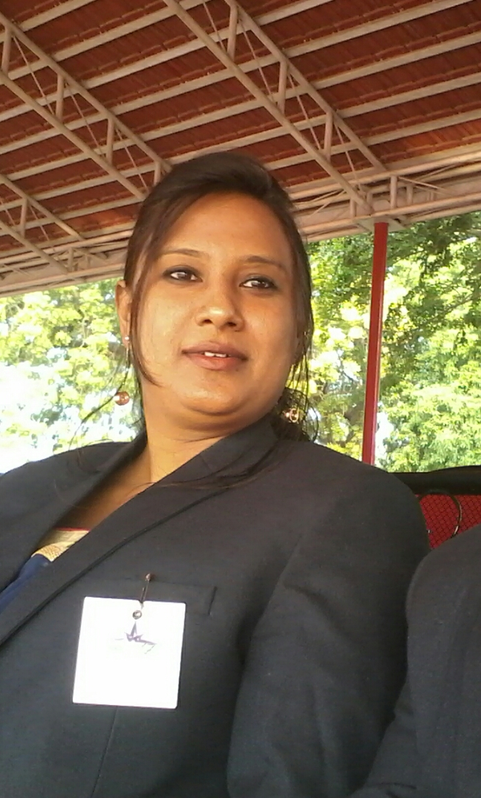
Academic Co-ordinator
Name : Mrs Ratna Shinde
Mobile No : 9595441578
Email: mlzsratna@gmail.com
Mount Litera Zee School, Ahmednagar

Slide 7
Guidelines For
Parents
Please check whatsapp group daily.
Kindly check the messages daily and follow the instructions wisely.
Communication should be done texting personal message to respective subject teacher or Ratna ma’am.
Kindly arrange proper Anroid mobile phone /laptop.
Please check /arrange proper net connection.
Make sure your child gets ready half an hour before the time given by teacher.
Please make sure that child sits in comfortable place .
Mount Litera Zee School, Ahmednagar

Slide 8
Guidelines For
Parents
Encourage your ward to participate in all the activities conducted.
Curtail the absenteeism, as it hampers the child’s learning process.
Daily teachers will take attendance and will be updated on eplus.
Mike should be off while online class.
Camera should be off while online classes.
No one allowed to speak during online teaching .
Students can type their query in chat box and than teacher will ask the particular child his/her query.
Assessment should be strictly solved ,given by teacher.
Mount Litera Zee School, Ahmednagar

Slide 9
Guidelines For
Parents
It is compulsory to attend all the sessions conducted by teachers.
Students can write their queries in chat box during online teaching .
There will be break after every lecture .
Whatsapp should be used only for genuine queries ,no personal or forwarded messages will be entertained .
Parents are requested not to speak with teacher during online classes .
Mount Litera Zee School, Ahmednagar

Slide 10
Elearning
We define eLearning as courses that are specifically delivered via the internet to somewhere other than the classroom where the teacher is teaching
It is interactive in that you can communicate with your teachers.
Elearning is at our finger tips by downloading below App in your mobiles.
Please check Whatsapp group for link.
Parents should download elearning app from play store
Elearning app
https://play.google.com/store/apps/details?id=com.innova.elearnings or other students in your class.
Mount Litera Zee School, Ahmednagar

Slide 11
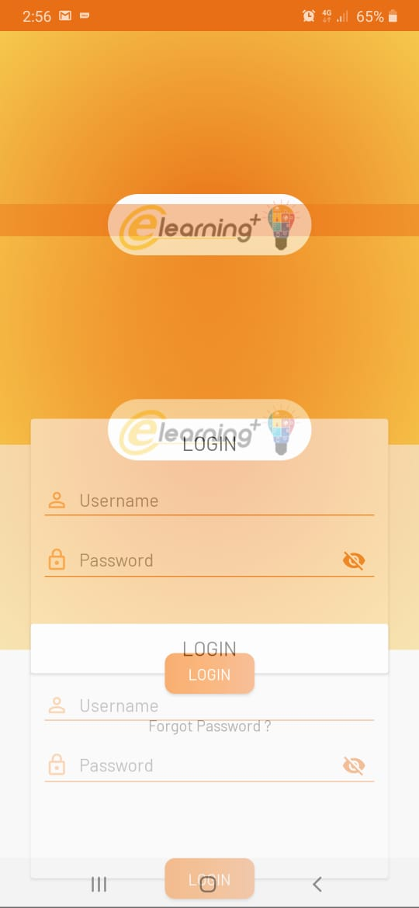
Elearning
When you will open the App you will have to type students ID and Password that we have sent on group for eg .STAM420 ID and password will be same STAM 420
Mount Litera Zee School, Ahmednagar

Slide 12
Elearning
After filling details you can get access to elearning.
Please see demo of elearning
We can get all details that how many students are using elearning for eg.
It is compulsory to attend all the sessions conducted by teachers.
Students can write their queries in chat box during online teaching .
There will be break after every lecture .
Whatsapp should be used only for genuine queries ,no personal or forwarded messages will be entertained .
Parents are requested not to speak with teacher during online classes .
Mount Litera Zee School, Ahmednagar

Slide 13
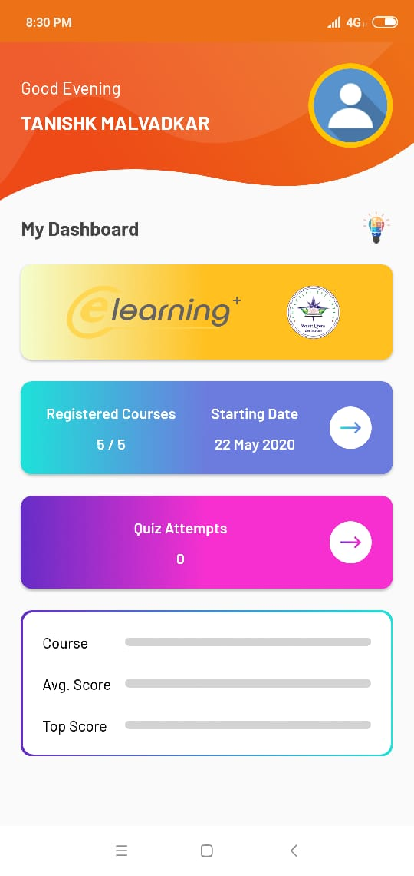
Elearning
Mount Litera Zee School, Ahmednagar

Slide 14
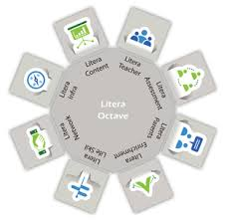
Unique child – centric teaching process
Litera Octave
Mount Litera Zee School, Ahmednagar

Slide 15

News letter
News letter
Every Month MLZS publishes a News Letter and they circulate in all MLZS Schools.
This letter contains commentary on the latest developments, current affairs, sports, knowledge meter and brain teasers.
This newsletter aims to cultivate a love of reading in students.
Students can also give their drawings ,riddles etc. to be published in this News letter.
Parents should motivate students for reading it.
Please check newsletter on our website www.mountliteraahmednagar.com
Mount Litera Zee School, Ahmednagar

Slide 16
Positive
Parenting Tips
Giving Your Child the Power of Positive Attitude during COVID-19.
One-on one timing makes children feel loved and secure, and shows them they are important.
Keeping children safe online during COVID-19.
Keep healthy routines.
Answer questions about the Pandemic simply and honestly .
Mount Litera Zee School, Ahmednagar

Slide 17
Feedback Hierarchy
For any queries, suggestions, feedbacks, complaints kindly follow the hierarchy:
Class Educator
Head Mistress
Principal
Regional School Director, ZLL
Sources of Feedback
Emails to Coordinators
Feedback to Front Office (FO)
Feedback during PTA meetings
Feedback to Hon. Chairman Sir
Mount Litera Zee School, Ahmednagar

Slide 18
Our Philosophy
Every child is unique. It is a well-known fact that no two thumbprints are alike. In the same way, we believe that every child is born unique. Each child has a unique brain network that shapes how she absorbs and responds to stimuli.
Mount Litera Zee School, Ahmednagar

Slide 19
THANK YOU
Mount Litera Zee School, Ahmednagar

